Slide 1
Predicting Readmission of Diabetic Patients in the US

Slide 2
Background
There are no formalized protocols for treating diabetic patients admitted under non-ICU conditions
Hospital readmission of diabetic patients has high economic cost
Cost per patient readmission is estimated to be around US$10591
Predicting hospital readmission from clinical records could help save economic and financial cost

Slide 3
Dataset
Dataset contains clinical records of diabetic patients who were admitted to US hospitals over a period of 10 years
Dataset was curated by Strack et al, 2014 from a comprehensive clinical records obtained from the Health Facts database
Dataset consists of 55 features such as patient demographics, medical tests and procedures conducted on the patients, etc
The target variable is the readmission outcome→ 3 outcomes, No readmission, readmitted after 30 days and readmitted within 30 days

Slide 4
Aim of this Project
Two aims
First, predict readmission of patients(< 30 and > 30) vs no readmission
Second, predict early readmission of patients(< 30 days) vs other outcomes(> 30 days and no readmission)

Slide 5
Exploratory Data Analysis

Slide 6
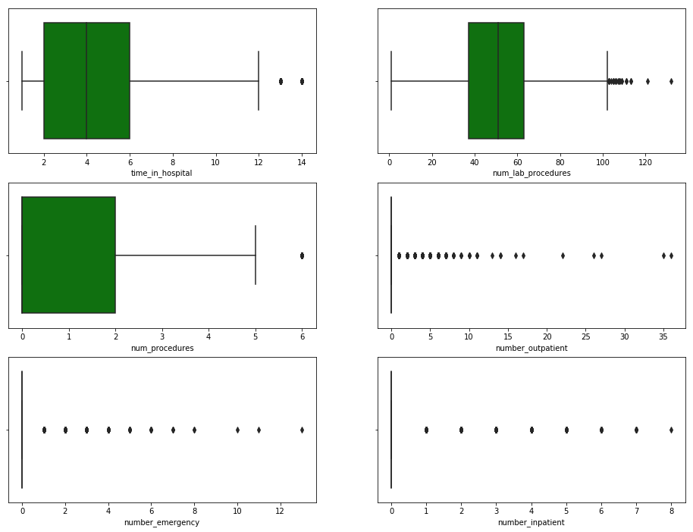
Distribution of Numerical Features

Slide 7
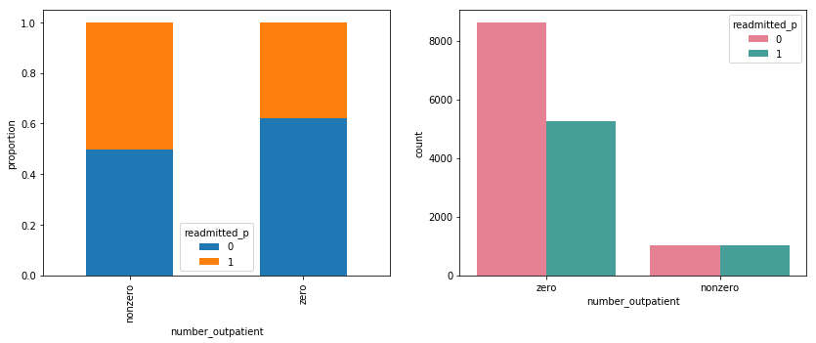
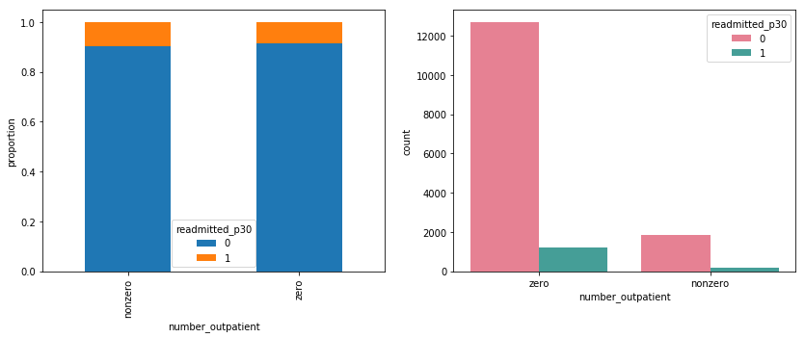

Slide 8
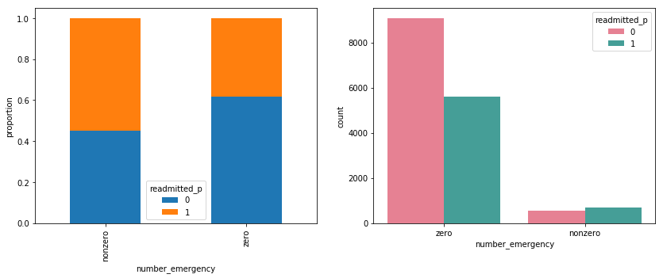
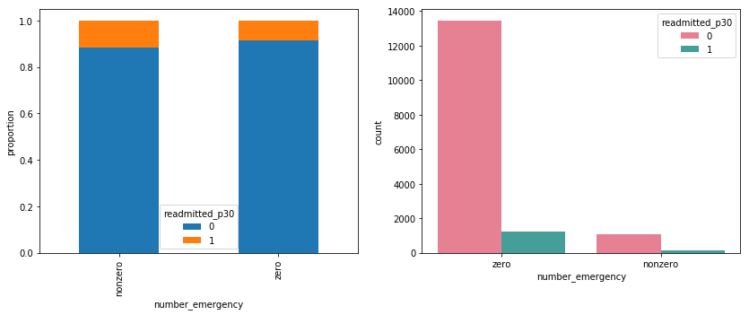

Slide 9
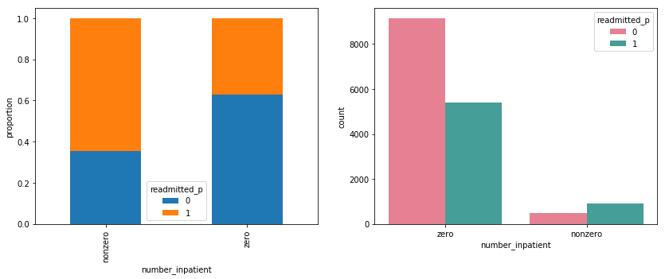
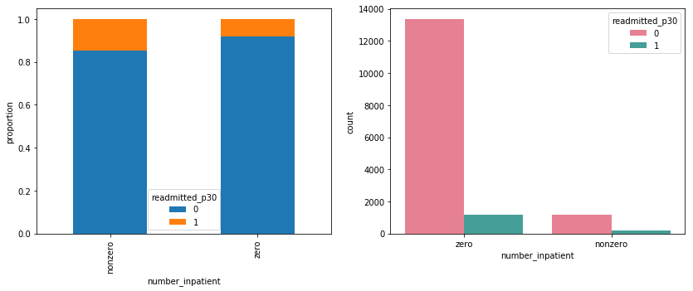

Slide 10
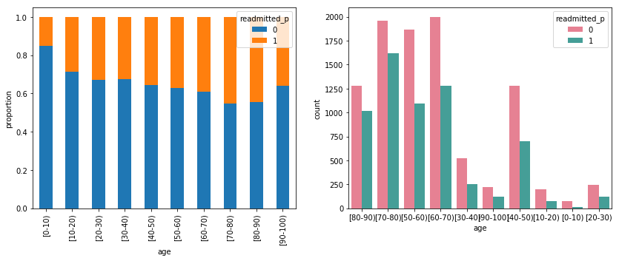
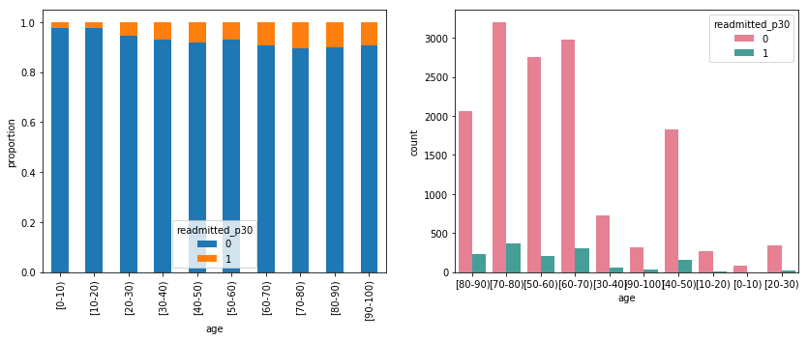

Slide 11
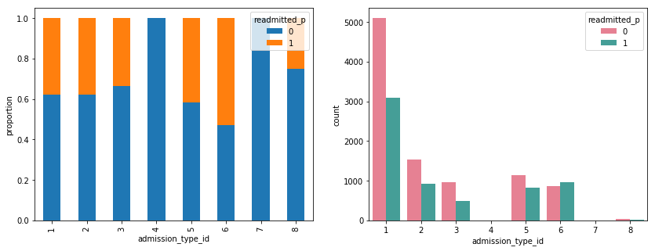
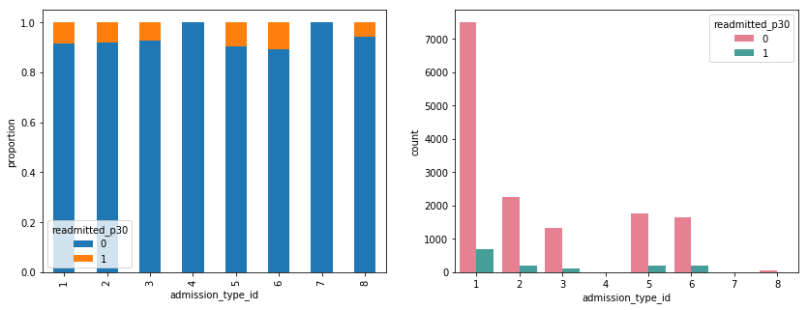

Slide 12
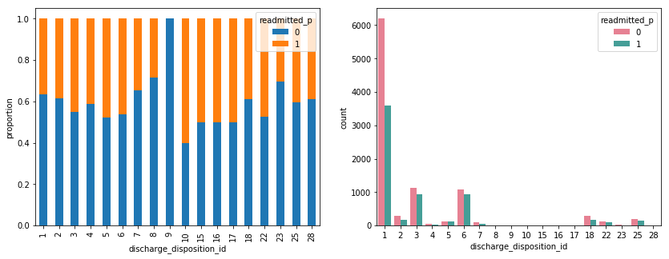
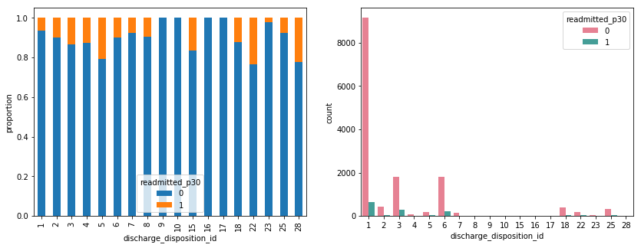

Slide 13
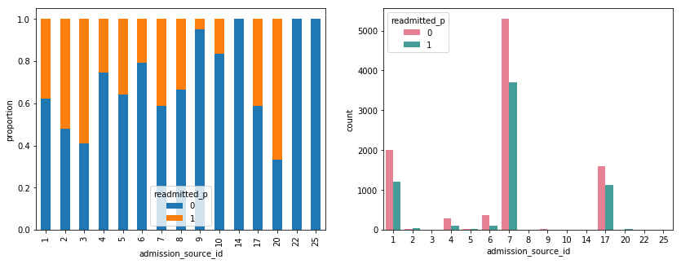
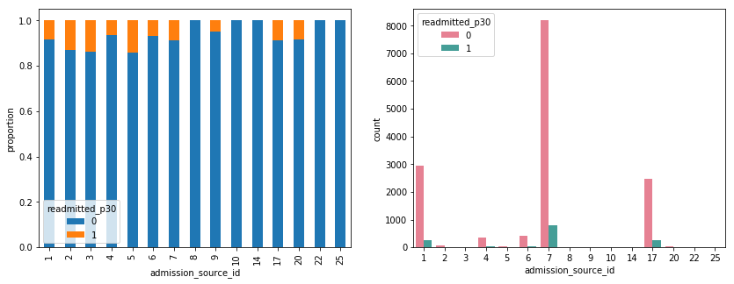

Slide 14
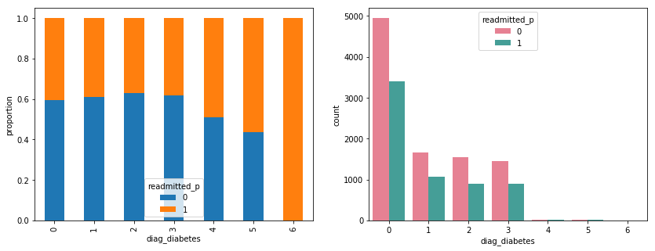
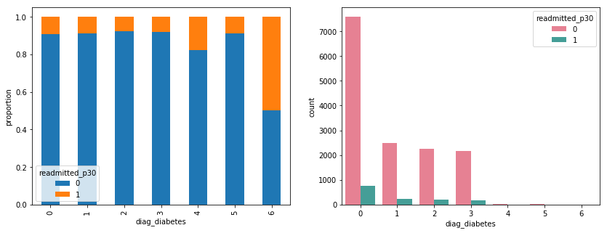

Slide 15
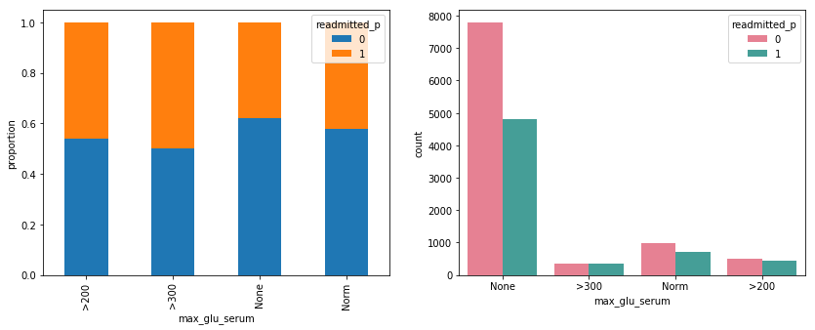
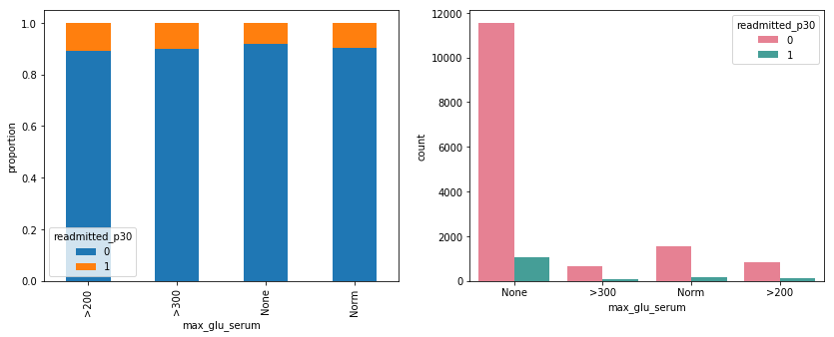

Slide 16
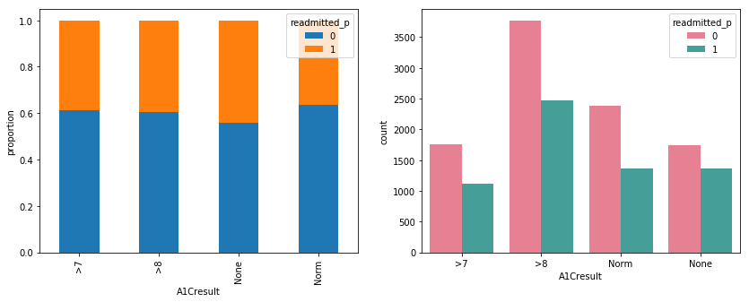
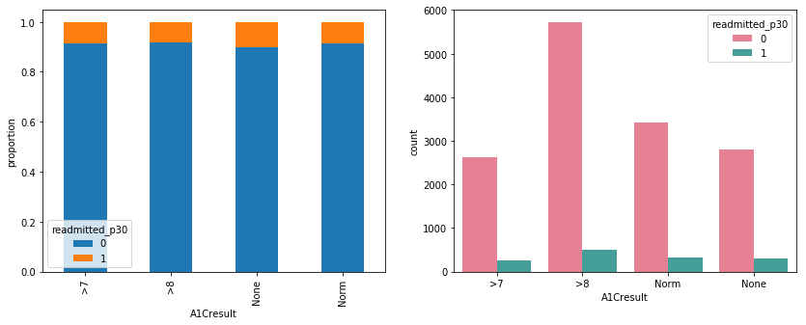

Slide 17
Results of Models

Slide 18
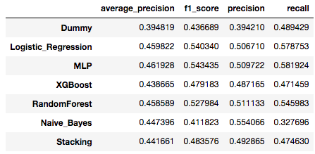
First Aim (Readmission vs No Readmission

Slide 19
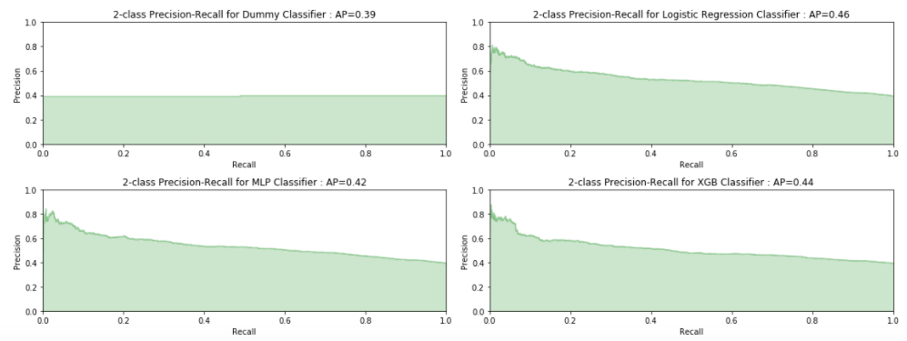
First Aim (Readmission vs No Readmission

Slide 20
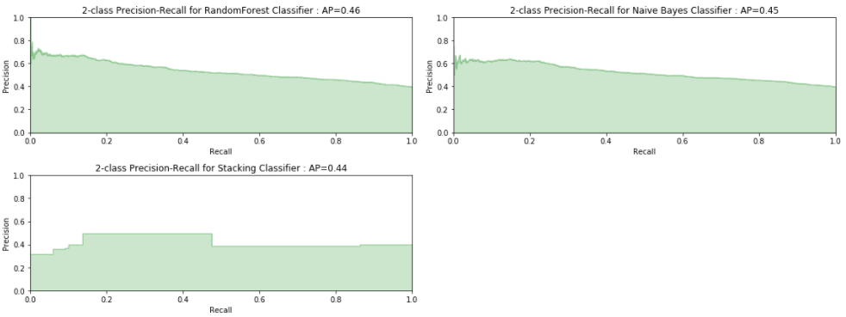
First Aim (Readmission vs No Readmission

Slide 21
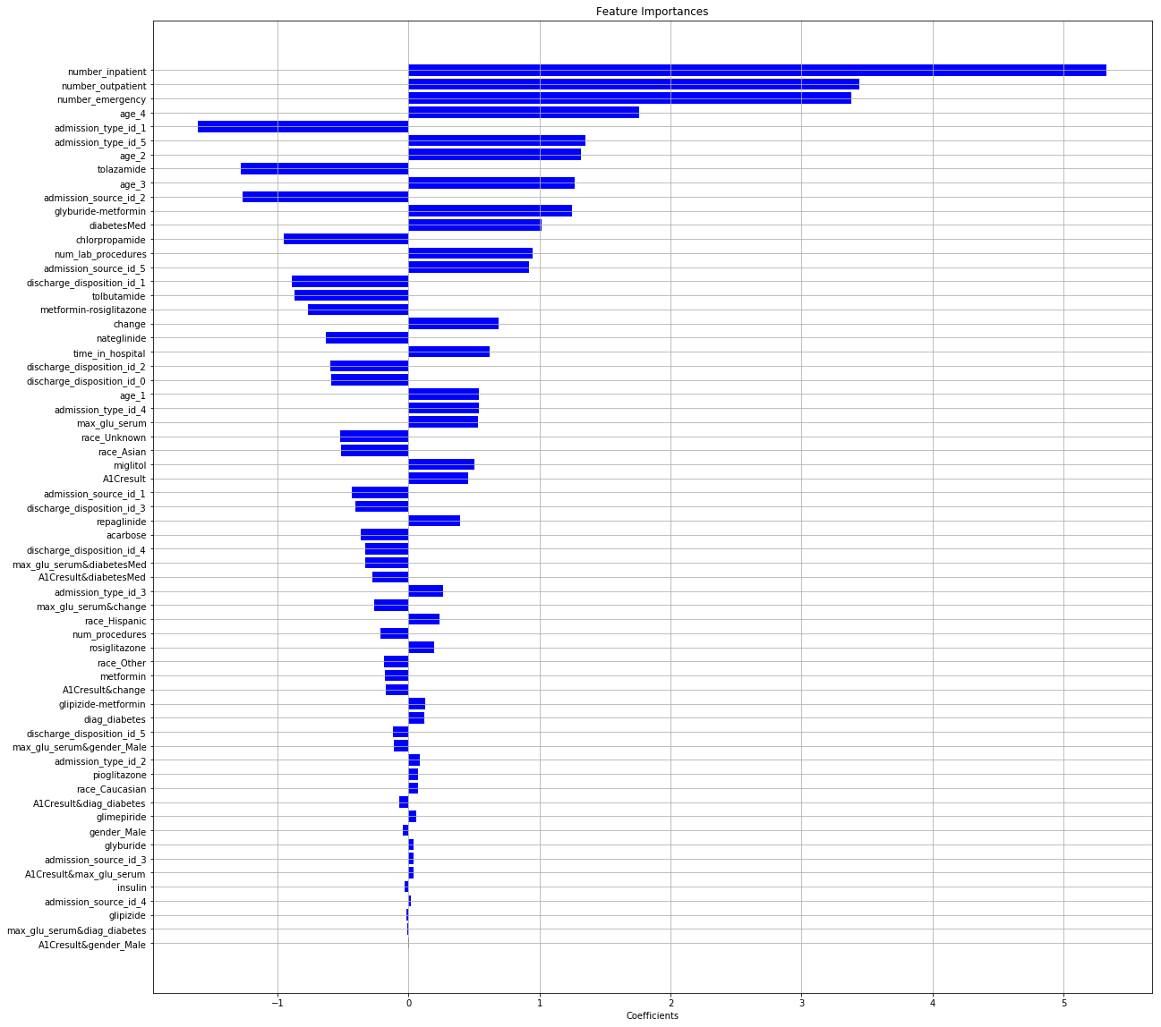

Slide 22
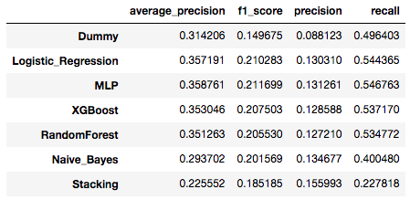
Second Aim (Early Readmission vs Others

Slide 23
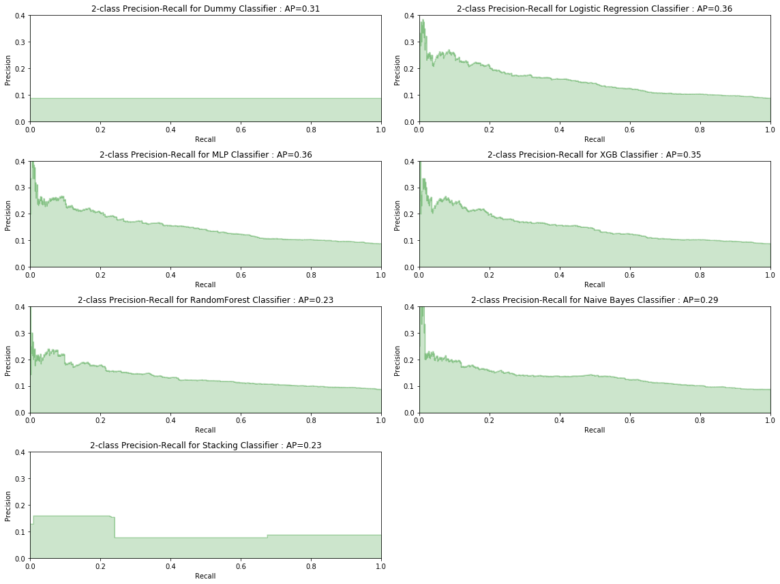
Second Aim (Early Readmission vs Others

Slide 24
Second Aim (Early Readmission vs Others

Slide 25
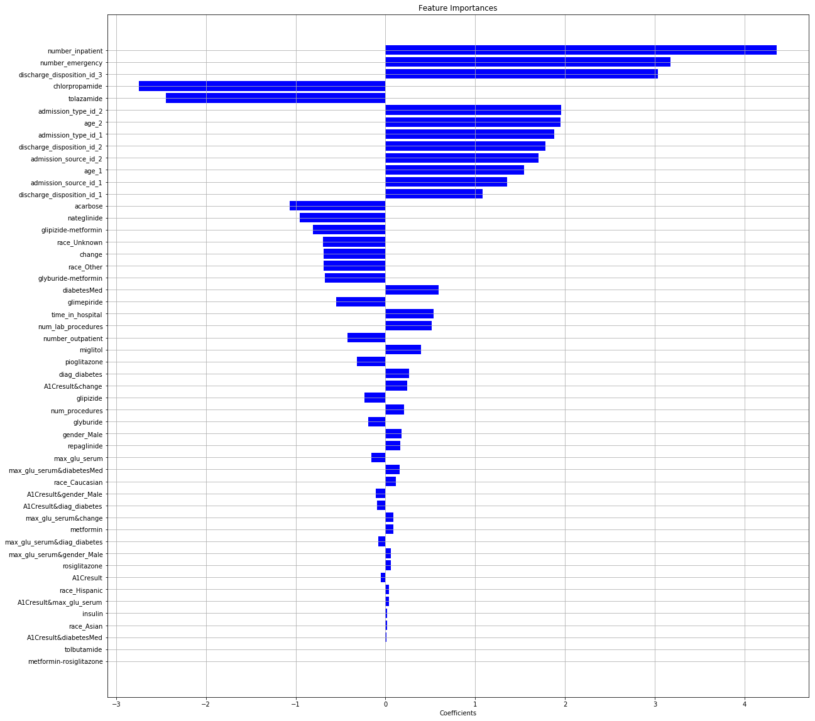

Slide 26
Future Work
Implement a cost matrix to get the savings from using this model to predict hospital readmission

